Slide 1
Outdoor Long Range Ubiquitous Projectiles Tracking System Using LoRa and Computer Vision
SharpShooter
12.14.2022

Slide 2







Team Members
Woojin Choi
Sun Moon University
Computer Vision & AI
Donghyeon Na
Sangmyung University
PM & Application developing
Jeongwon Moon
Kyungpook National University
Networking
Hansu Jeong
Sangmyung University
IoT
Sophia Lee
Purdue University
Research & Networking
Minjae Kim
Kyung Hee University
Computer Vision & AI
Ethan O’Sullivan
Purdue University
Research & Networking

Slide 3
Contents
01
02
03
04
05
Project Overview
Technical Description
Background
Experiments
Conclusion
Networking
Sound detection
Computer vision
Application

Slide 4
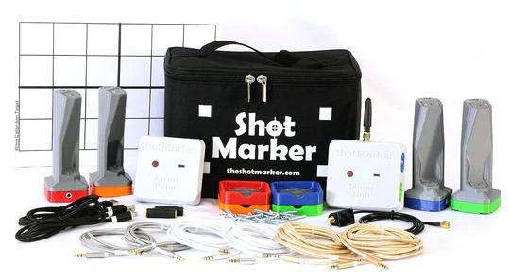
Background
ShotMarker

Slide 5
Background
Problems
Environmental Factors
Accuracy
Flexibility

Slide 6

Project Overview
Long Range Communication
Low Latency & Packet Loss
Features
Accuracy
Flexibility

Slide 7
















Project Overview
Shooter
Target
pi2
pi1
LoRa

Slide 8
Technical Description - Networking
LoRa
Websocket & HTTP

Slide 9
Technical Description - Networking
Problem of LoRa
Latency
Packet Loss

Slide 10
Technical Description - Networking
Destination Extended Unique Identifier (6 Bytes)
Sequence Number (2 Bytes) | Flag (1 Byte) | Payload Size (1 Byte) | One’s Complement Checksum (2 Bytes)
Payload (228 Bytes)
P-MPLR(Point to point Multi Packet Long Range) Protocol

Slide 11
Technical Description - Networking
Transmitter
Receiver
SYN
SYN-ACK
DATA
BVACK
4-handshake

Slide 12

Technical Description – Sound Detection
Class | # of Data
Gun Shot | 6,560
Air Conditioner | 1,000
Car Horn | 429
Children Playing | 1,000
Dog Bark | 1,000
Drilling | 1,000
Engine Idling | 1,000
Jackhammer | 1,000
Siren | 929
Speech | 581
Street Music | 1,000
Urbansound8K
Gunshot Audio Forensics Data
Voice & Shooting range sound

Slide 13
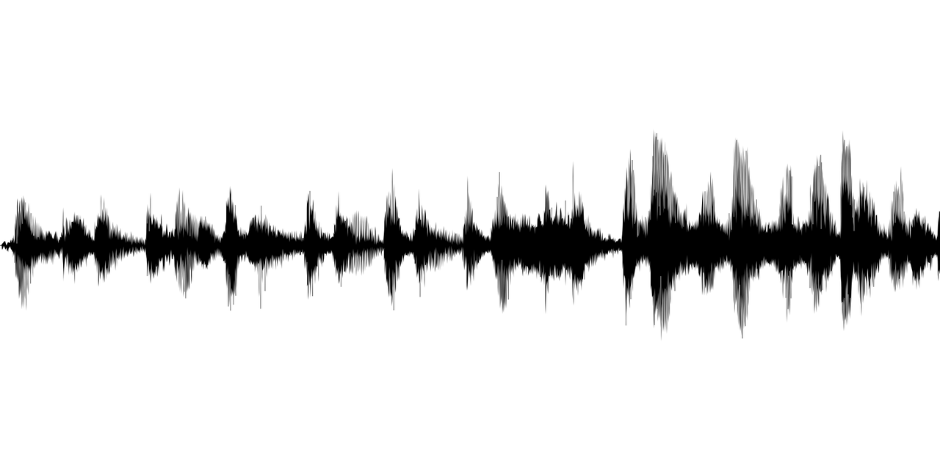

Technical Description – Sound Detection
Input
Signal
Window Length
Overlapping Window
Hop
Length
Overlap
Length
n_fft : 1,024 (23.3ms)
hop_length : 512
frame : 87
Windowed segments
FFT
FFT Output 1
FFT Output 2
FFT Length
FFT Output 3

Slide 14
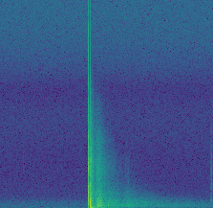
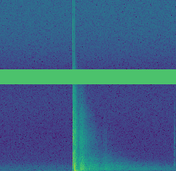
Technical Description – Sound Detection
Data Augmentation : Frequency Masking
Frequency Domain
Frequency Masking

Slide 15
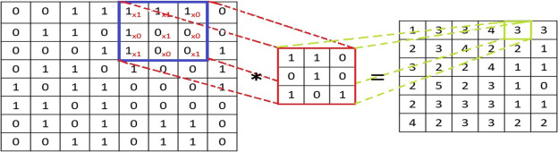
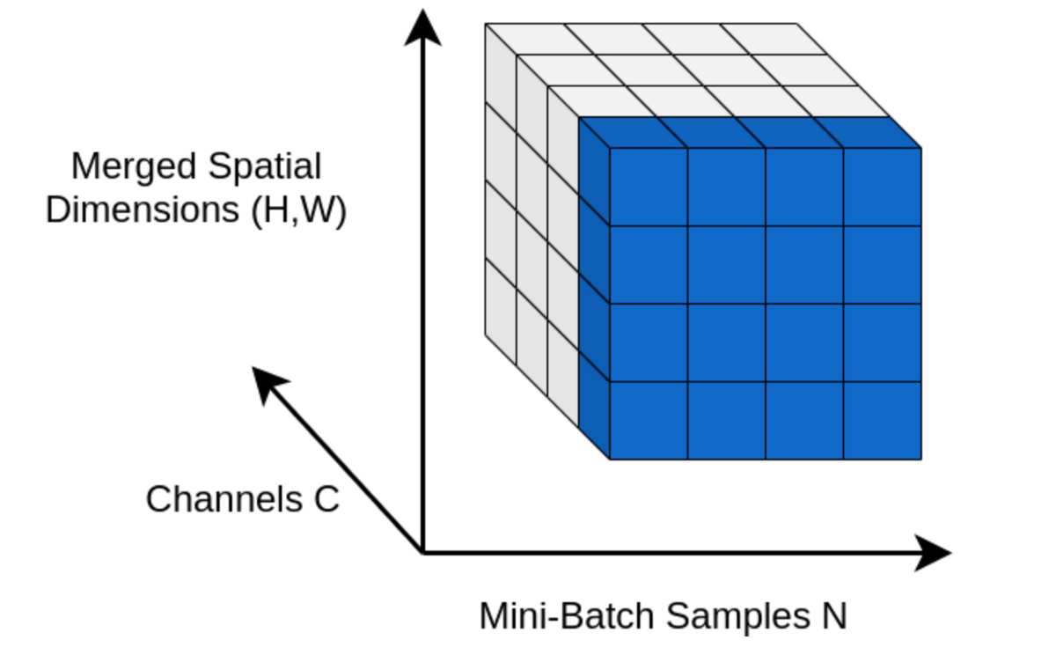
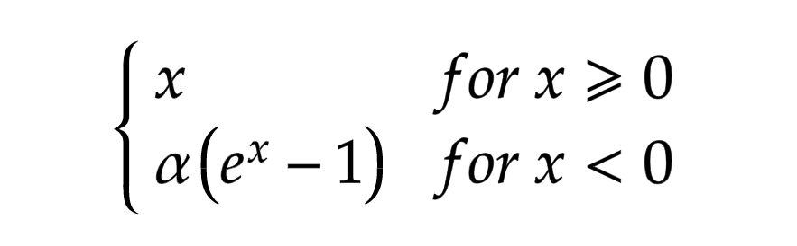
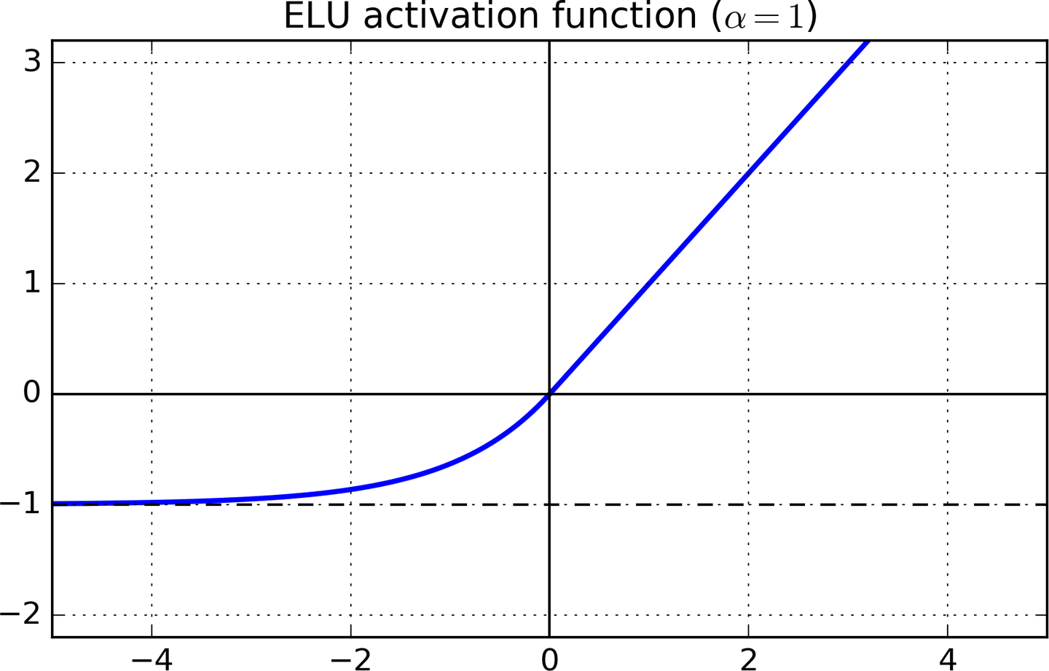

Technical Description – Sound Detection
Sound Detection : Convolutional Neural Network(CNN) Model
- Convolutional Layer
Spectrogram
Conv Layer
Conv2D
https://production-media.paperswithcode.com/methods/MaxpoolSample2.png
- Batch Normalization
Conv Layer
BatchNorm2D
Conv Layer
ELU
MaxPool2D
- ELU(Exponential Linear Unit)
Conv Layer
FC Layer
https://blog.paperspace.com/content/images/2018/06/ELU.png
- MaxPool2D
https://assets-global.website-files.com/5d7b77b063a9066d83e1209c/60be1d44cdd90474e0430225_math-20210607%20(14).png
Gunshot Sound Clasification
https://production-media.paperswithcode.com/methods/MaxpoolSample2.png

Slide 16
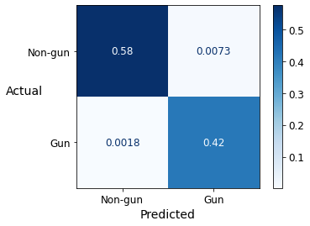
Technical Description – Sound Detection
Sound Detection : Model Performance
Model Parameters
Batch Size : 256
Learning Rate : 0.001
Loss Function : Cross Entropy
Optimizer : Adaptive Gradient (AdaGrad)
Accuracy : 99.1%
F1-Score : 98.9%

Slide 17
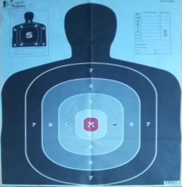
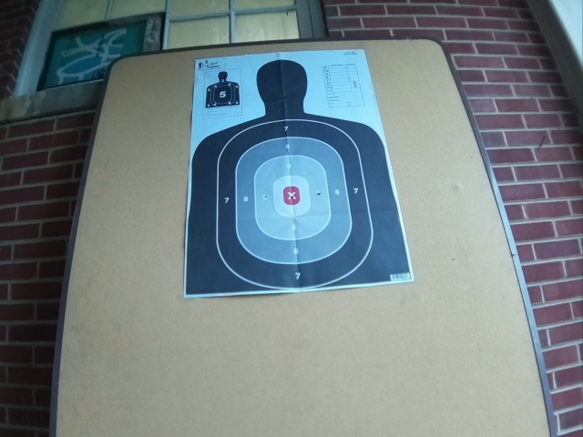
Technical Description – Computer Vision
Target Detection
Perspective
Transformation
Original image
Contour
RGB → YUV
Closing
Y component
Homomorphic Filter
Pixel Filtering
Gamma Correction
Canny Edge Detection

Slide 18
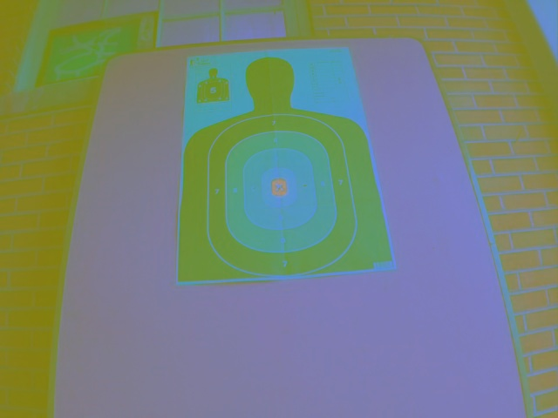
Technical Description – Computer Vision
Target Detection : RGB to YUV
YUV
Conversion

Slide 19
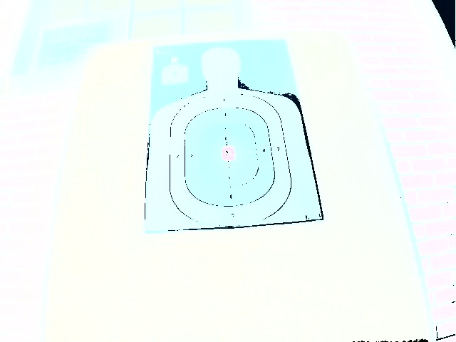
Technical Description – Computer Vision
Target Detection : Homomorphic Filtering
FFT
High Pass Filter
Low Pass Filter
Scaling Factor
IFFT
Exponential
operation
Spatial Domain Form Image
HPF(High Pass Filter) , LPF(Low Pass Filter) : Filter for separate the low and high frequency components

Slide 20
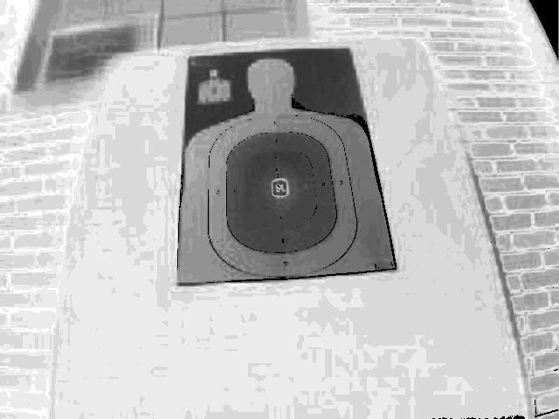
Technical Description – Computer Vision
Target Detection : Gamma Correction
Gamma Correction

Slide 21
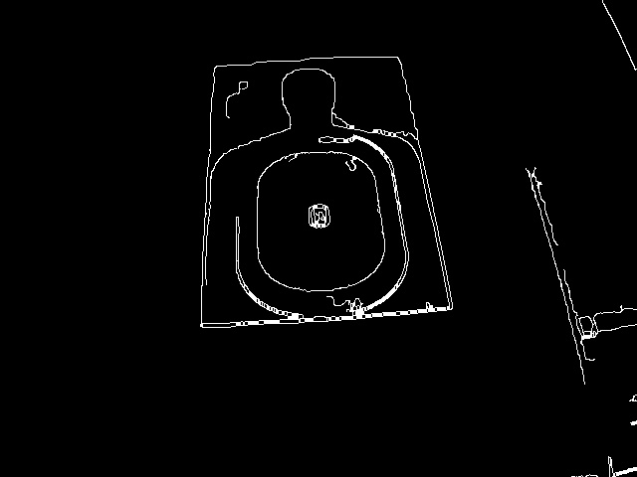
Technical Description – Computer Vision
Target Detection : Edge Detection
Canny Edge
Detection
+
Closing
Operation

Slide 22
Technical Description – Computer Vision
Target Detection : Perspective Transformation
2D
3D
Perspective Transformation
Target Portion

Slide 23
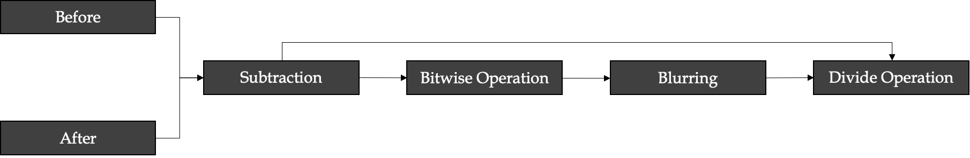
Technical Description – Computer Vision
Coordinate Detection

Slide 24



Technical Description – Computer Vision
Coordinate Detection : Pixel Subtraction
Pixel Subtraction
Before
After

Slide 25

Technical Description – Computer Vision
Coordinate Detection : Intensity Transformation
Bitwise Operation
Subtracted image

Slide 26

Technical Description – Computer Vision
Coordinate Detection : Blurring & Dividing
Blurring

Slide 27


Technical Description – Computer Vision
Coordinate Detection : Extract the coordinate
morphologyEx Function
+
Contour
Shooting Point Coordinate

Slide 28
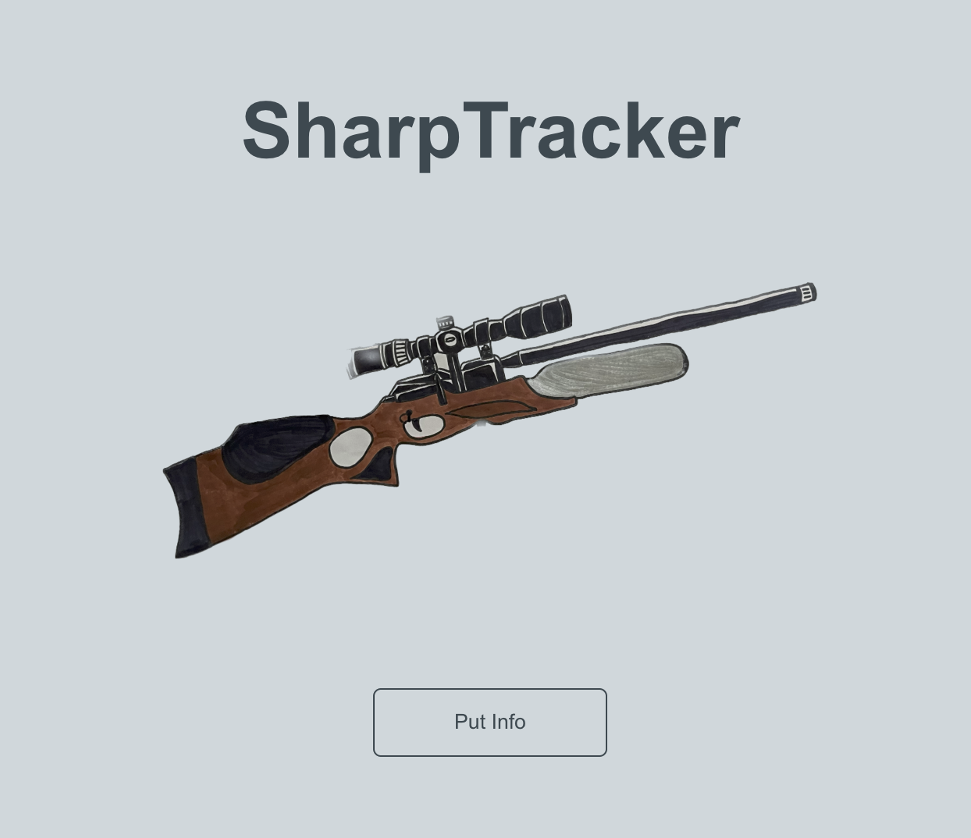
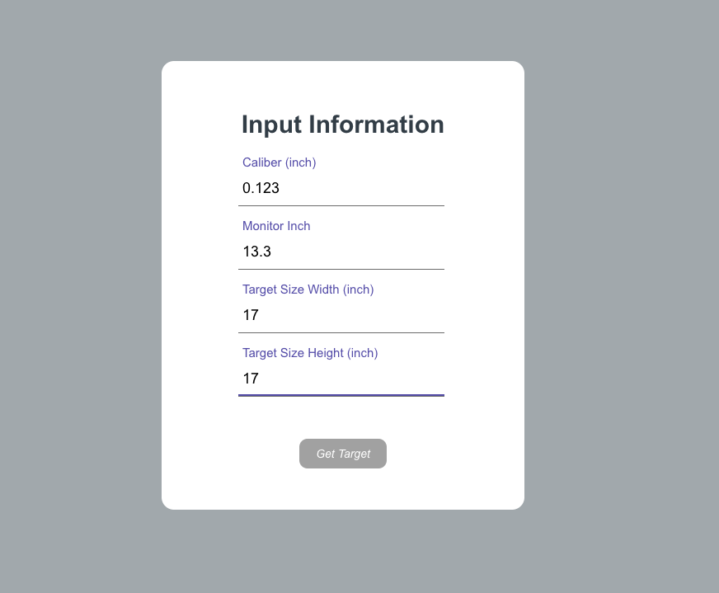
Technical Description – Application
Before the system starts
Main Page
For calculation of Shot Group

Slide 29
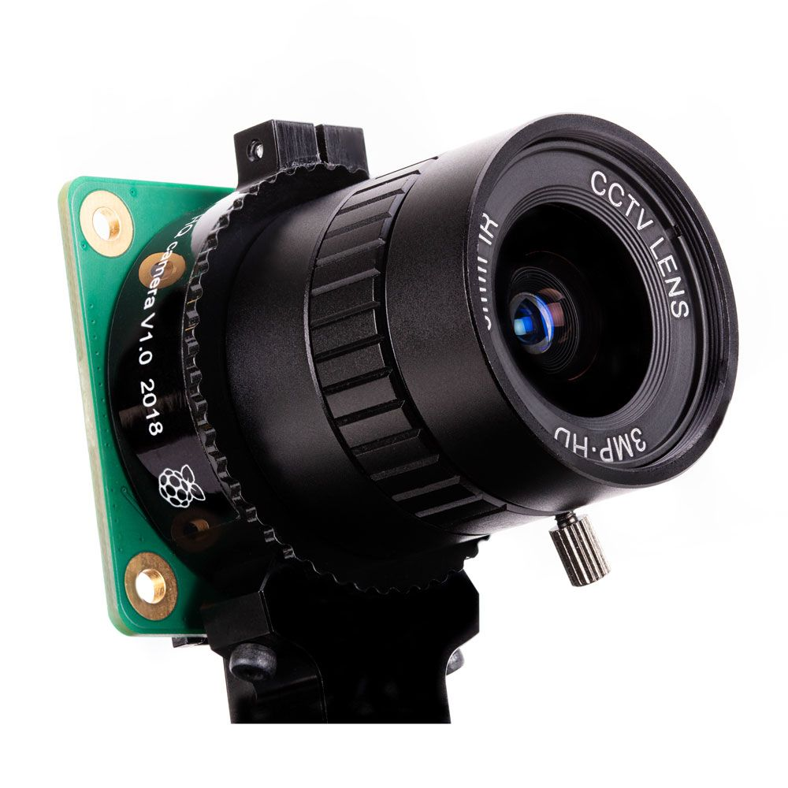


Technical Description – Application
When the system starts
initial image
byte file
Pi 1 camera
Node.js Server
Web

Slide 30
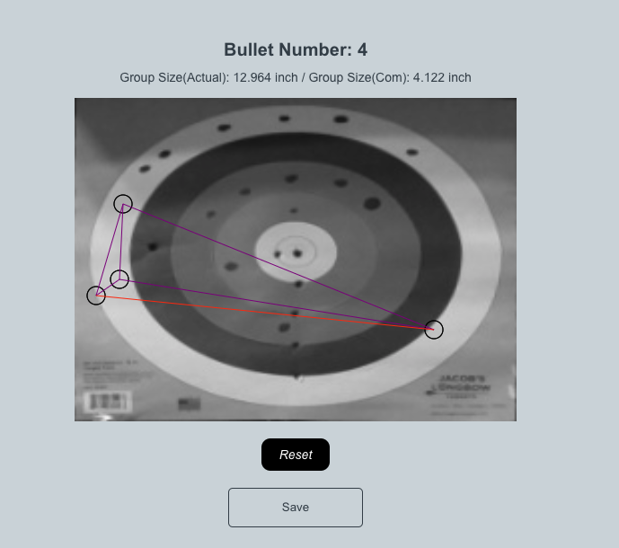
Technical Description – Application
When shooting occurs
Projectile Position
Shot Group Size

Slide 31
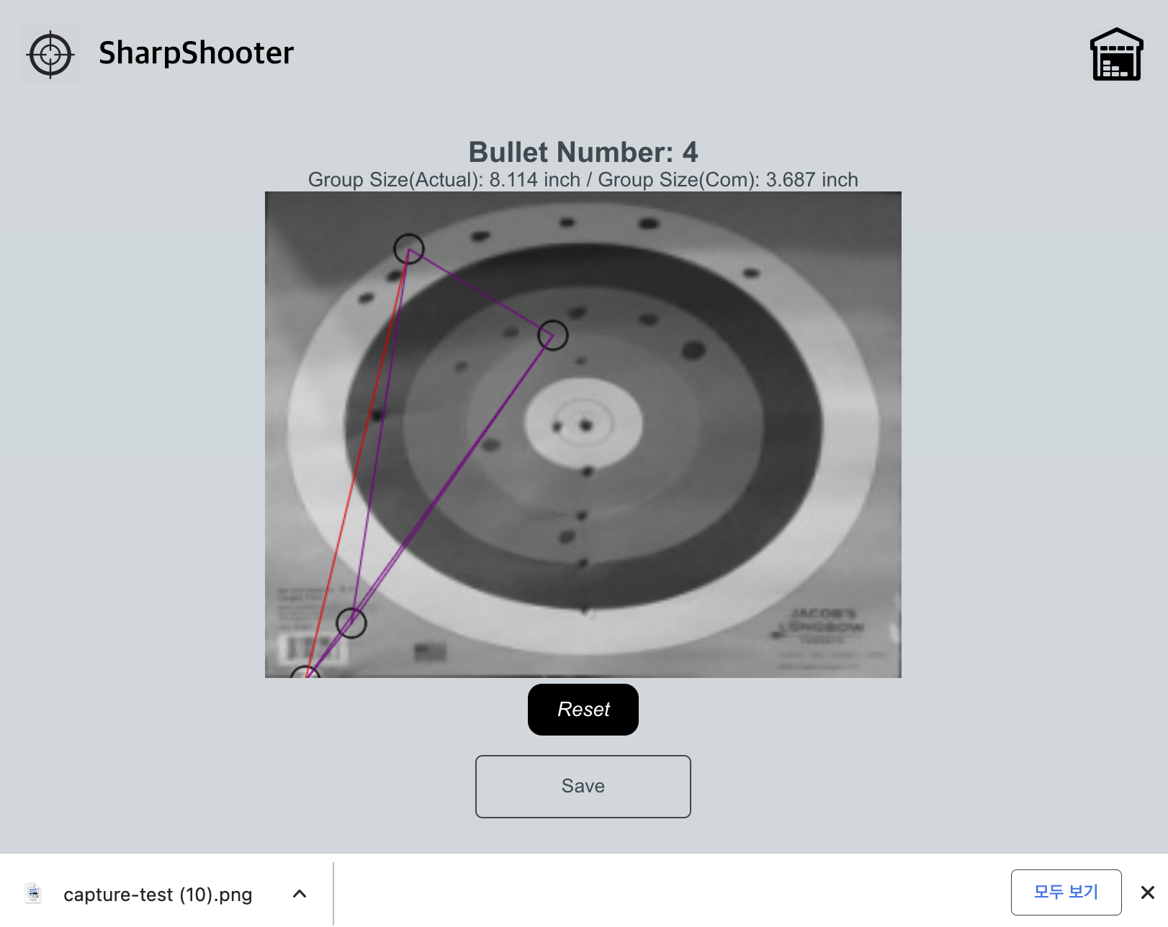
Technical Description – Application
After press save button

Slide 32
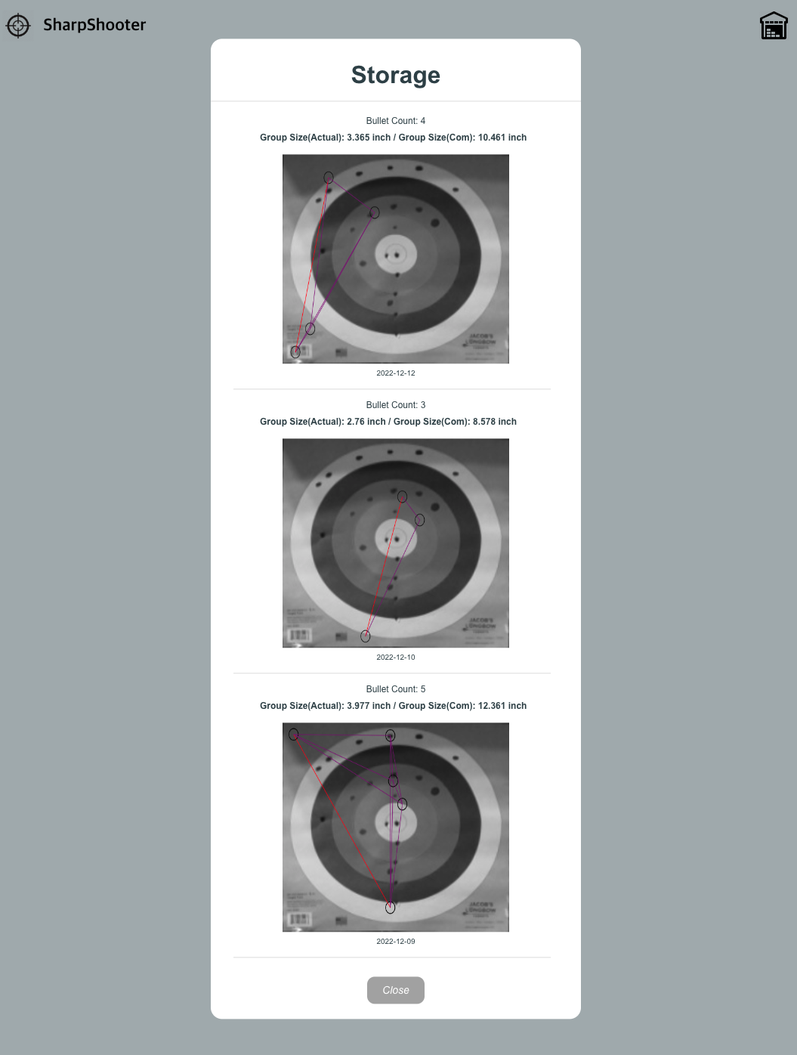
Technical Description – Application
In a storage
Bullet number
Group size (Actual ver.)
Group size (Computer ver.)
Save date
Image
Shotmark
Grouping

Slide 33
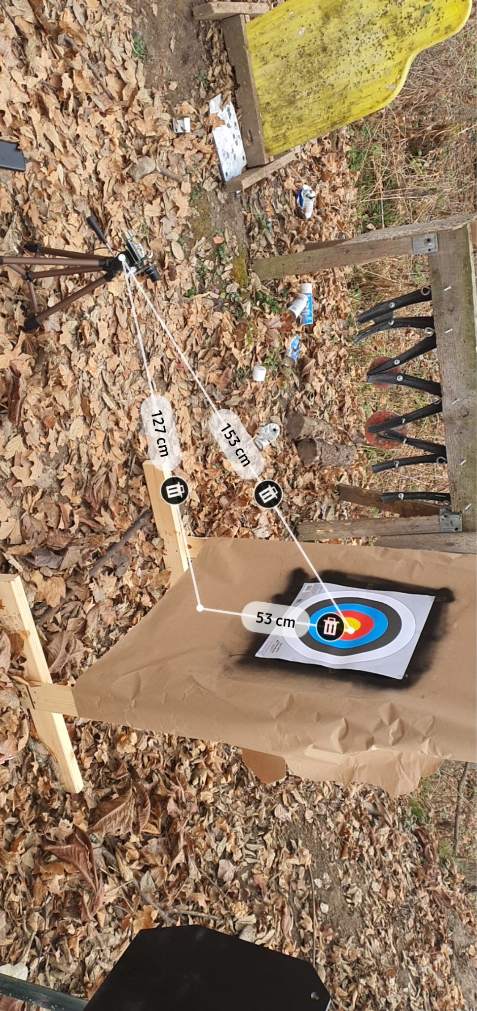
Experiments
1st Outdoor Test
Date & Time | 11.11.2022 3 PM
Location | 13626 S 525 W, Romney, IN 47981
Temperature | 7 °C
Wind velocity | Southeast 21 km/h

Slide 34
Experiments
Need to supplement
Control light and environment where the edge detection works accurately
Collect more gun sound dataset using silencer to increase the accuracy of sound detection

Slide 35
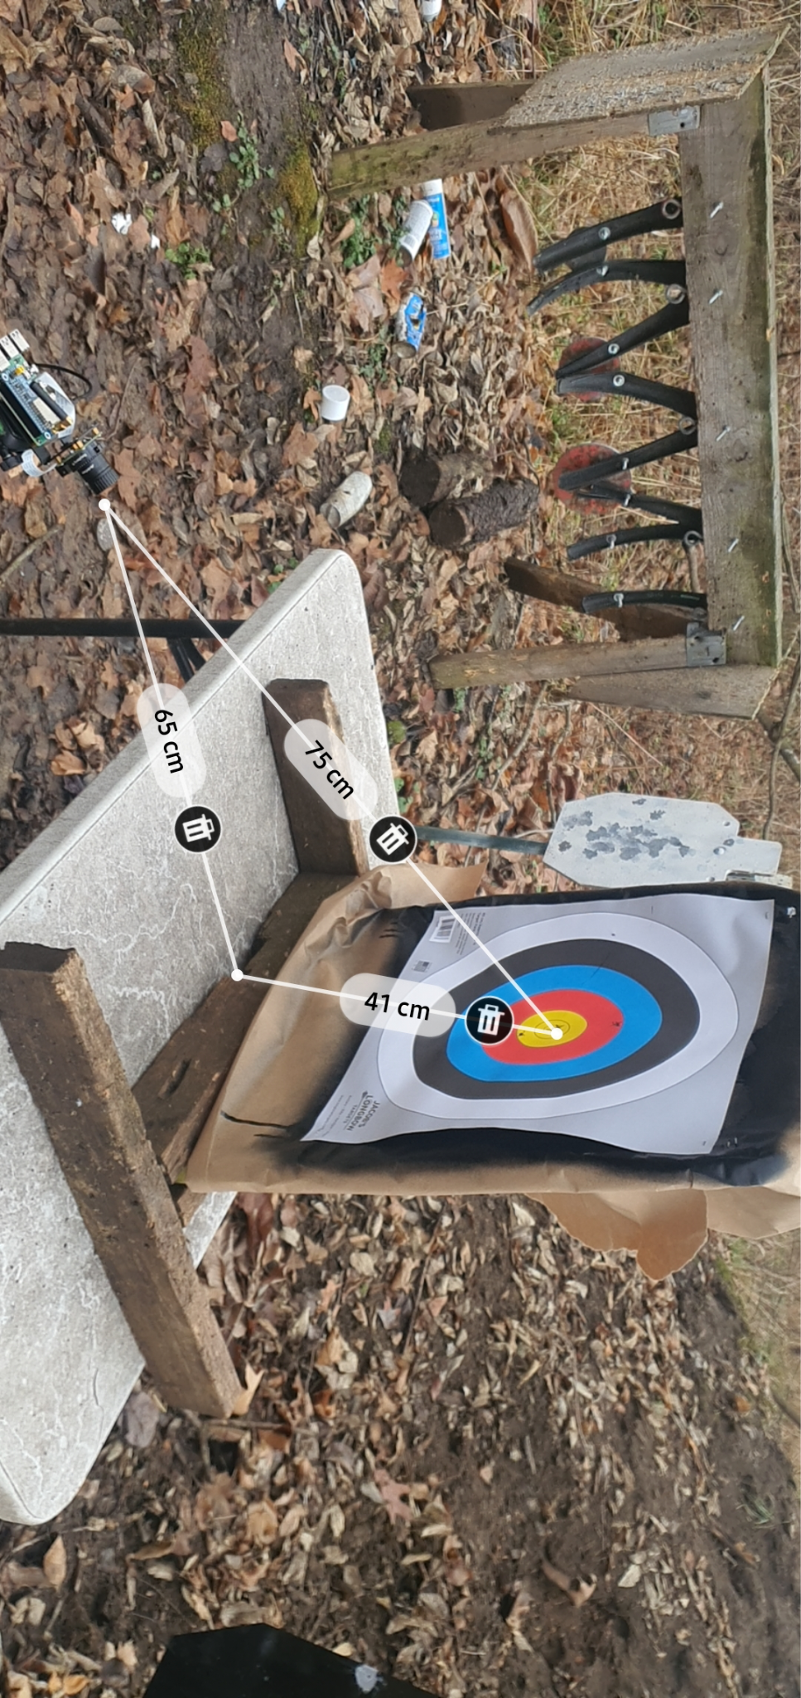
Experiments
2nd Outdoor Test
Date & Time | 12.09.2022 1 PM
Location | 13626 S 525 W, Romney, IN 47981
Temperature | 4 °C
Wind velocity | East 13 km/h

Slide 36
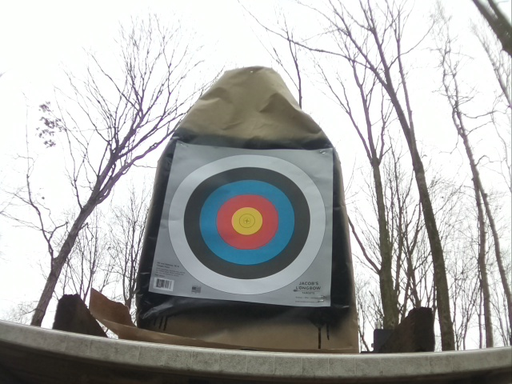
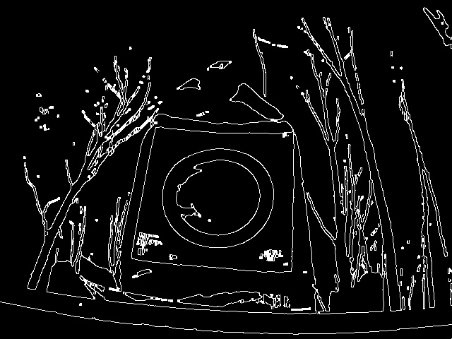
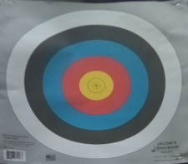
Experiments
Extract the target image
Original image
Canny edge detection
Extracted image

Slide 37
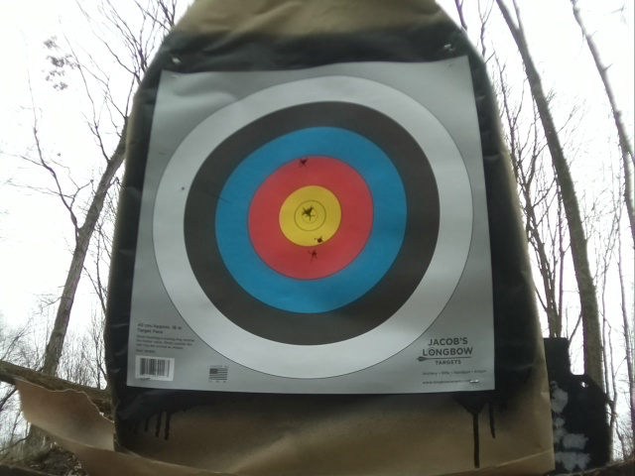
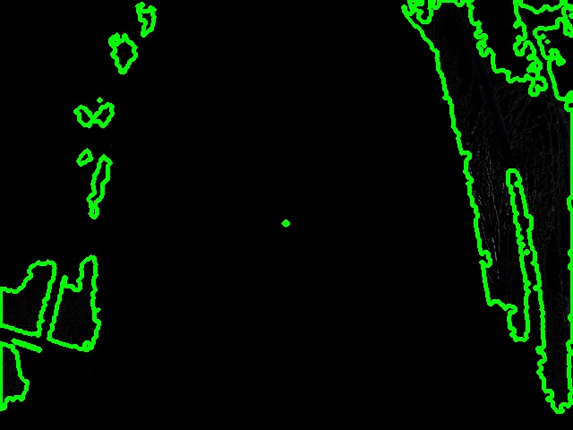
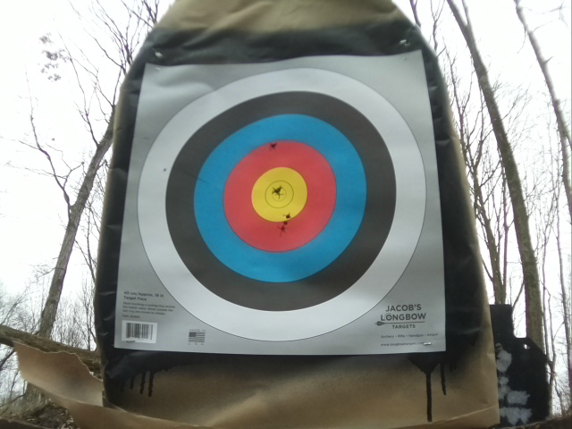
Experiments
When the gunshot is occurred
Before
changed pixel
After

Slide 38
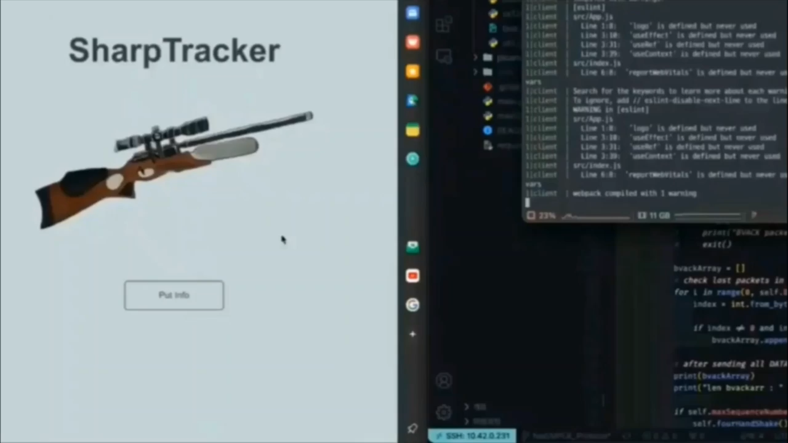
Experiments – Demo Video

Slide 39
Conclusion
LoRa
find the exact projectile
without checking the target physically
Computer
Vision
Sound
detection

Slide 40
Conclusion
Advantage
1. Convenience
2. High accuracy
3. No limitation on bullet type
Useful for military training and shooting competition

Slide 41
Future Plans
The system can operate well without being affected by environmental settings
The system can detect various kinds of projectile

Slide 42
Reference
[1] A. Karp, “Estimating Global Civilian-held Firearms Numbers”, Small Arms Survey, Jun. 2018 [Online]. Available: https://www.smallarmssurvey.org/resource/estimating-global-civilianheld-firearms-numbers
[2] A. MacDonald, ShotMarker Manual. (2020). [Online]. Available: https://autotrickler.com/pages/support
[3] J. M. Ferguson. “The Chicago police department’s use of ShotSpotter technology.” igchicago.org. https://igchicago.org/wpcontent/uploads/2021/08/Chicago-Police- Departments-Use-of-ShotSpotter-Technology.pdf (accessed Aug. 2021).
[4] A. S. Rawat, J. Rajendran, H. Ramiah and A. Rana, “LoRa (Long Range) and LoRaWAN Technology for IoT Applications in COVID-19 Pandemic,” 2020 International Conference on Advances in Computing, Communication & Materials (ICACCM), 2020, pp. r419-422, doi:
10.1109/ICACCM50413.2020.9213067.
[5] D. Andreea, “OnTaget: An Electronic Archery Scoring,” 2021, arXiv preprint arXiv:2104.01622.
[6] T. T. Zin, I. Oka, T. Sasayama, S. Ata, H. Watanabe and H. Sasano, “Image Processing Approach to Automatic Scoring System for Archery Targets,” 2013 Ninth International Conference on Intelligent Information Hiding and Multimedia Signal Processing, 2013, pp. 259-262, doi: 10.1109/IIH-MSP.2013.73.
[7] S. Park et al., “Feasibility of Measuring Shot Group Using LoRa Technology and YOLO V5,” 2022 IEEE Sensors Applications Symposium
(SAS), 2022, pp. 1-6, doi: 10.1109/SAS54819.2022.9881356.
[8] S. Li, H. Guo, W. Sun and X. Sun, “A low-illuminance image enhancement method in YUV color space,” 2022 14th International Conference on Measuring Technology and Mechatronics Automation (ICMTMA), 2022, pp. 286-291, doi: 10.1109/ICMTMA54903.2022.00062.
[9] W. Wang et al., “Weak-Light Image Enhancement Method Based on Adaptive Local Gamma Transform and Color Compensation”, Journal of Sensors, 2021, 18, doi: 10.1155/2021/5563698
[10] F. Demir, D. A. Abdullah and A. Sengur, “A New Deep CNN Model for Environmental Sound Classification,” in IEEE Access, vol. 8, pp.
66529-66537, 2020, doi: 10.1109/ACCESS.2020.2984903.

Slide 43
Reference
[11] T. Chen, D. Eager and D. Makaroff, “Efficient Image Transmission Using LoRa Technology In Agricultural Monitoring IoT Systems,” 2019 International Conference on Internet of Things (iThings) and IEEE Green Computing and Communications (Green-Com) and IEEE Cyber, Physical and Social Computing (CPSCom) and IEEE Smart Data (SmartData), 2019, pp. 937-944, doi: 10.1109/iThings/GreenCom/CPSCom/SmartData.2019.00166.
[12] S. Devalal and A. Karthikeyan, “LoRa Technology - An Overview,” 2018 Second International Conference on Electronics, Communication and Aerospace Technology (ICECA), 2018, pp. 284-290, doi: 10.1109/ICECA.2018.8474715
[13] G. M. Murch, "Physiological principles for the effective use of color," in IEEE Computer Graphics and Applications, vol. 4, no. 11, pp. 48-55, Nov. 1984, doi: 10.1109/MCG.1984.6429356.
[14] C. Poynton, "YUV and luminance considered harmful: A plea for precise terminology in video," www.inforamp.net, 2001
[15] O’Shea, K., Nash, R. An Introduction to Convolutional Neural Networks. ArXiv, abs/1511.08458, 2015.
[16] Clevert, D., Unterthiner, T., & Hochreiter, S. Fast and Accurate Deep Network Learning by Exponential Linear Units (ELUs). arXiv: Learning, 2016.
[17] Ioffe, S., & Szegedy, C. Batch normalization: Accelerating deep network training by reducing internal covariate shift. In International conference on machine learning (pp. 448-456). PMLR, 2015.
[18] Duchi, John, Elad Hazan, and Yoram Singer. "Adaptive subgradient methods for online learning and stochastic optimization." Journal of machine learning research 12.7 (2011).
[19] J. Salamon, C. Jacoby and J. P. Bello, "A Dataset and Taxonomy for Urban Sound Research," Nov. 2014. [Online]. Available: https://urbansounddataset.weebly.com/urbansound8k.html
[20] Gunshot Audio Forensics Dataset, Development of Computational Methods for the Audio Analysis of Gunshots, NIJ grant 2016-DN-BX-0183, Jun. 2018. [Online]. Available: http://cadreforensics.com/audio/
[21] Z. Chi, Y. Li and C. Chen, “Deep convolutional neural network combined with concatenated spectrogram for environmental sound classification,'' 2019 IEEE 7th International Conference on Computer Science and Network Technology (ICCSNT), pp. 251-254, 2019.

Slide 44




Q & A
Hansu Jeong
Sangmyung University
IoT
Contact : 201710982 @ sangmyung.kr
Minjae Kim
Kyung Hee University
Computer Vision & AI
Contact : kmj5596 @ khu.ac.kr
Woojin Choi
Sun Moon University
Computer Vision & AI
Contact : twinsno119 @ sunmoon.ac.kr
Donghyeon Na
Sangmyung University
PM & Application developing
Contact : 201721402 @ sangmyung.kr
Jeongwon Moon
Kyungpook National University
Networking
Contact : bella7365 @ knu.ac.kr

Slide 45
Thank You
SharpShooter

